Slide 1
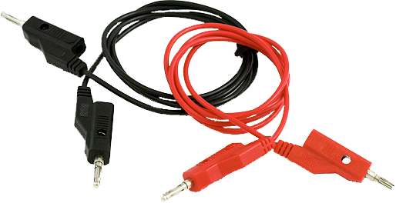
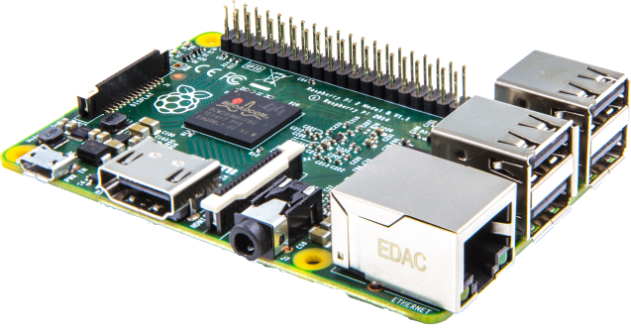
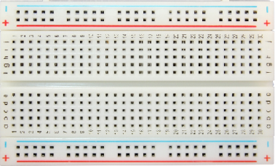

Humber Parts
Gurpreet Jhita

Slide 2


Introduction
Humber Parts is a smart and innovative way to manage inventory and equipment rental at the parts crib
With Humber Parts our mission is to bring a modern touch to the parts crib in order to make the experience better for both the employees and students
Currently the parts crib is using an ancient system involving paper and pen
Ancient

Slide 3
Proposal
Our product uses a webcam to scan barcodes to make it simple to rent equipment and sign out using your student number
We also integrated a database server that is linked to a mobile app in order to manage rented equipment and see what is available to rent

Slide 4
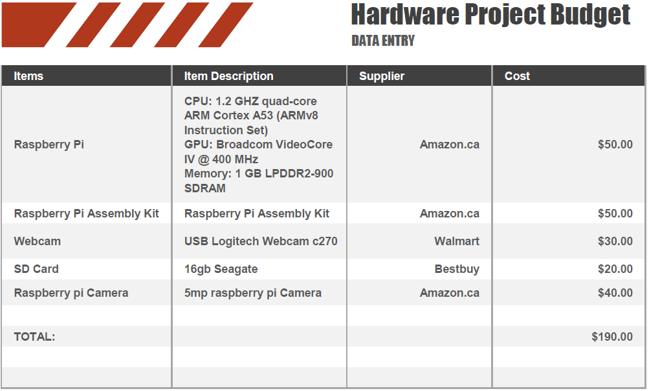
Project Budget
Our budget for the project was a $200.00 and we managed to stay within the given budget and acquire all the necessary parts.

Slide 5
Schedule
Week 1 Created Github
Week 2 Project Proposal
Week 3 Project Gantt Chart
Week 4 Project Budget Report
Week 5 Hardware Acquisition
Week 6 Mechanical Assembly
Week 7 Power Up Milestone
Week 8 Placard
Week 9 30 Second Build Video
Week 10 Project Demo / Progress Report
Week 11 Build Log / Progress Report
Week 12 Build Log / Progress Report
Week 13 Presentations

Slide 6

Build Video
A Short video of the raspberry pi assembly

Slide 7
Previous Course Knowledge
Using the skills learned such as:
Java Programming and Databases,
PC Hardware,
Electric Circuits,
Embedded Systems,
Micro Assembly,
Software Engineering and
Internet Programming

Slide 8
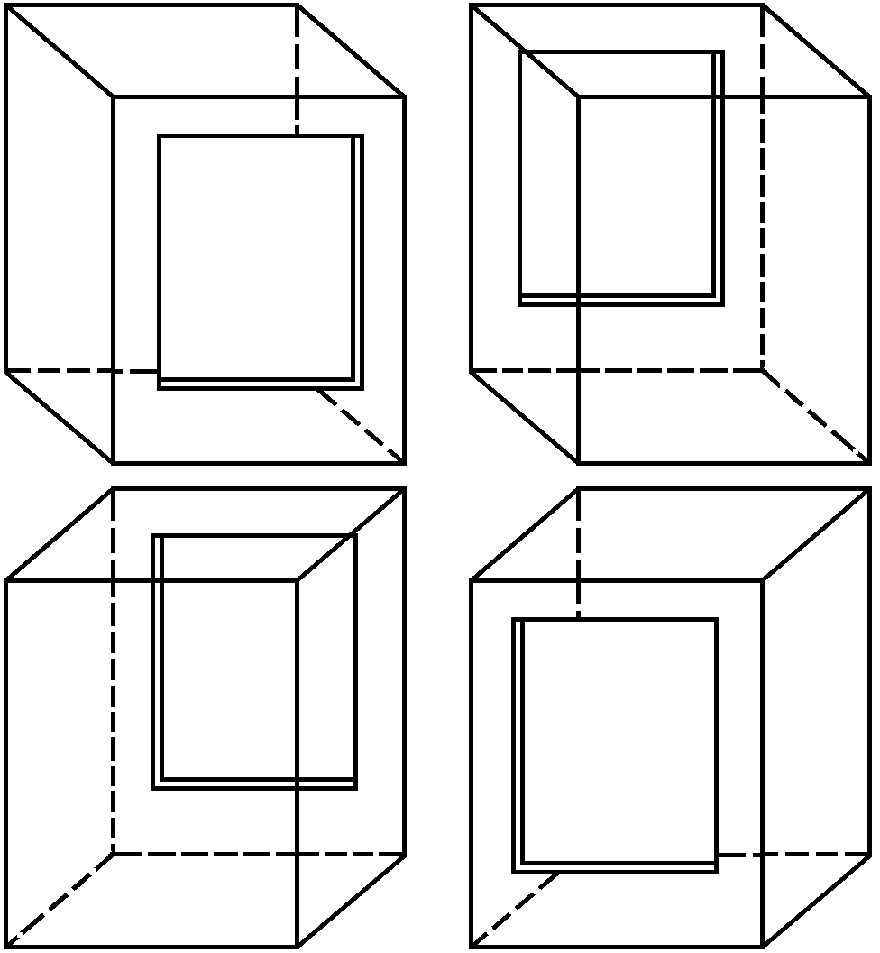
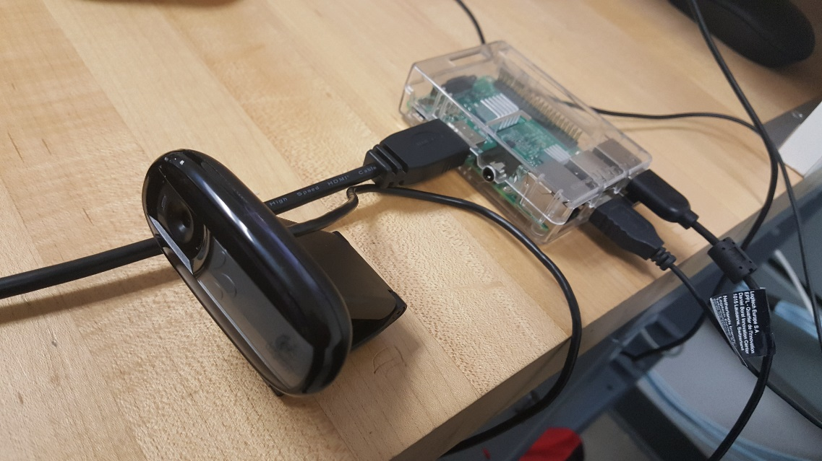
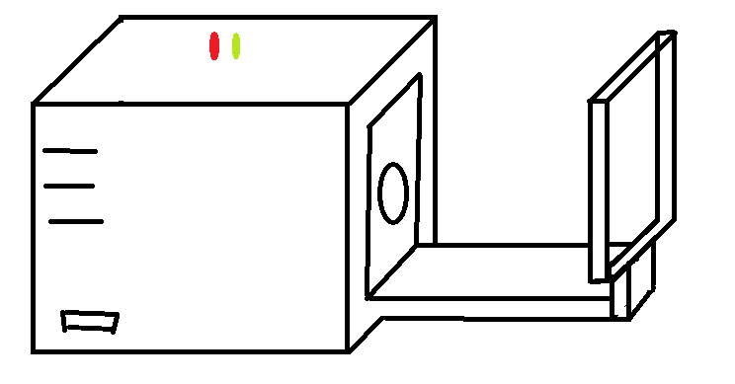
Some Images

Slide 9
Thank you

